Slide 1

Embedded System HW 02: Compile Linux Kernel
Department of Computer Science and Information Engineering
Shuo-Han Chen (陳碩漢), shchen@csie.ntut.edu.tw
Hong-Yue Technology Research Building 334
R 09:10 - 12:00
Notes:
Good Afternoon everyone
I am Shuo-Han Chen, a postdoctoral research fellow at Academia Sinica
It is a great honor to be invited by the department for being here today

Slide 2
Purpose for this Homework
Goal : Learn how to compile Linux Kernel
Download the kernel source (https://www.kernel.org/)
-> wget https://cdn.kernel.org/pub/linux/kernel/v5.x/linux-5.9.2.tar.xz
Unpack the downloaded file
-> tar xvf linux-5.9.2.tar.xz
Configure the Linux kernel features and modules
-> cd linux-5.9.2
-> cp -v /boot/config-$(uname -r) .config
Install package that will be used during compiling
-> sudo apt-get install build-essential libncurses-dev bison flex libssl-dev libelf-dev
2
Notes:
Here is more detail about me. I started working as a postdoctoral research fellow at the Institute of Information Science, Academia Sinica since March 2018
During my fellowship, I have been to the Purdue University USA and the Chinese University of Hong Kong for visiting
Before my fellowship, I spent two and half years for my phd degree at the CS Department of National Tsing Hua University
My research interests mainly lies in
the next generation memory/storage architecture designs
Emerging non-volatile memory and storage technologies
Low power system designs for artificial neural networks
In the past few years, I have revived few awards and a best paper nomination at DAC conference, which is a top rated conference in the EDA field

Slide 3
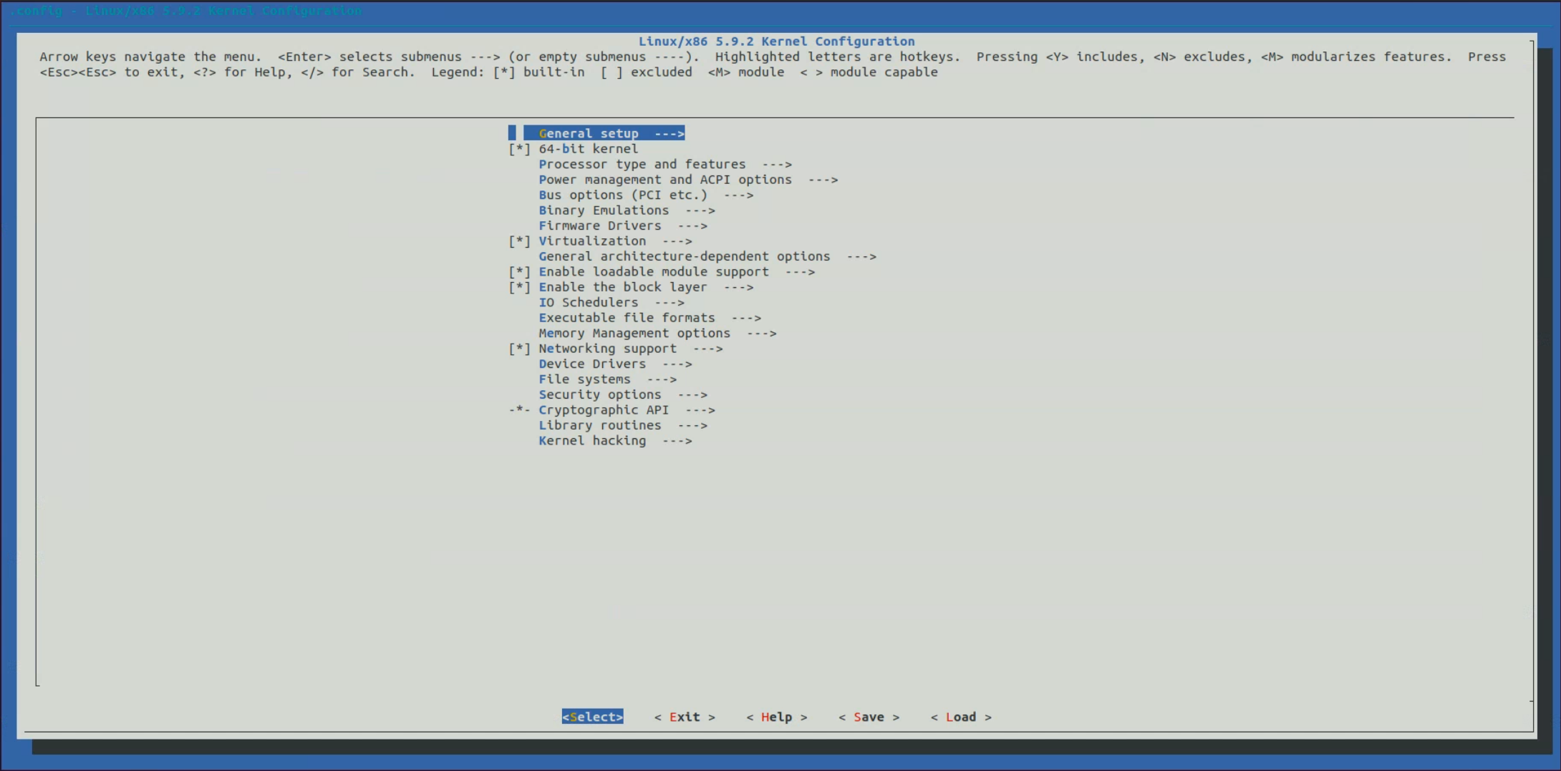
Purpose for this Homework
Try this, it’s where we can turn on/off a feature in Linux Kernel
-> make menuconfig
Type make to compile and screen the result in your report
3
Notes:
Here is more detail about me. I started working as a postdoctoral research fellow at the Institute of Information Science, Academia Sinica since March 2018
During my fellowship, I have been to the Purdue University USA and the Chinese University of Hong Kong for visiting
Before my fellowship, I spent two and half years for my phd degree at the CS Department of National Tsing Hua University
My research interests mainly lies in
the next generation memory/storage architecture designs
Emerging non-volatile memory and storage technologies
Low power system designs for artificial neural networks
In the past few years, I have revived few awards and a best paper nomination at DAC conference, which is a top rated conference in the EDA field

Slide 4

Q & A
Remember to submit your report.
Deadline is set to 11/7 24:00 !
Late submission will be not accepted !
Notes:
Thank you for listening. Now, I would like to end today’s talk by the Q & A time.

